Slide 1
The Use of Natural Language Processing in Detecting Trends of Cyberbullying in Social Media among Filipino Adolescents
Samantha Mallari
Faith Ballesteros
Eva Samillano

Slide 2
Event Table
Event | Trigger | Source | Use Case | Response | Destination
The moderator wants to run the system | The moderator presses ‘Run’ | Moderator | Moderator enables plug in | System starts operating | Moderator
The moderator wants to check reports regarding posts which contains indications of cyberbullying | The system encounters text or posts in social media | Post | The moderator receives graphical reports | System converts data in graphical reports and stores it in its own database | Moderator
The moderator wants to validate the system by adding new words in the database |  | Moderator | Moderator validates the system | The system’s database is updated | System

Slide 3
Background of the Problem
How did bullying change over a period of time?
-Its first discovery on primates
-During the era of the Homo-sapiens
-Bullying in the 21st century
Bullying-like behaviors are part of the human nature

Slide 4
Background of the Problem
Introduction to cyberbullying
-Definition of cyberbullying
Cyberbullying in the Philippines
-Why should we be concerned?
-The difference on how we deal with cyberbullying compared to other countries

Slide 5
Statement of the Problem
How can Natural Language Processing be used to detect trends of cyberbullying in social media sites among Filipino adolescents?

Slide 6
Objective
To apply Natural Language Processing (NLP) technology to aid in the efforts of moderators by detecting cyberbullying occurrences in social media sites automatically while they remain subtle

Slide 7
Significance
Adolescents spend more time on social networking sites compared to other age groups
Drawback:
-They are still immature
-They are not likely to tell anyone that they are being bullied
Effects of cyberbullying on an individual can spread to people whom that person frequently interacts with

Slide 8
Scope and Limitations
The project will focus on detecting and analyzing cyberbullying events which will most likely revolve around issues considered sensitive nationwide
The system will analyze posts that are available to the public
The posts must be exchanged between adolescents (people aged 10-19 years old)
The moderator is the only actor expected to directly interact with the system

Slide 9
Scope and Limitations
The provided solution will be limited to the detection of cyberbullying trends in two human languages (Tagalog and English) only
The machine’s “understanding” will be based on the context of how these particular social media posts are usually being constructed by Filipino netizens

Slide 10
Review of Related Literature
In Japan, Niita, Masui, Ptaszynski, Kimura, Rzekpka, and Araki conducted a research entitled Detecting Cyberbullying Entries on Informal School Websites Based on Category Relevance Maximization. The researchers proposed three methods in conducting their system: phase extraction, categorization and harmful word detection together with harmfulness polarity determination and relevance maximization.
Chen, Zhu, Zhou, and Xu conducted a research on Detecting Offensive Language in Social Media to Protect Adolescent Online Safety. In their study, the team proposed the Lexical Syntactical Feature (LSF) approach to identify offensive contents in social media and to predict a user’s potentiality to send out offensive contents.

Slide 11
Review of Related Literature
In 2012, Dinakar, Jones, Havasi, Lieberman, and Picard conducted a research on Common Sense Reasoning for Detection, Prevention and Mitigation of Cyberbullying. Removing of stop-words and tokenizing the text to separate words from punctuation marks were performed.
In 2015, Van Hee et al, conducted a research on Automatic Detection and Prevention of Cyberbullying. The team developed an annotation scheme for the analysis of textual cyberbullying.

Slide 12
Technical Background
DATA COLLECTION
We constructed a corpus by collecting data from different social networking sites such as Facebook (groups), Twitter and Ask.fm
Through web scraping, we were able to obtain preliminary data for our dataset. The web scraping tool that we used for obtaining our data was Import.io
We were able to collect more than 3000 posts (made by Filipinos) in their respective social networking accounts

Slide 13
Theoretical Background
Ervin Goffman introduced the mechanisms of audience segregation. He describes how people play different roles in different situations. It is a mechanism wherein an individual perform roles, in order to create a favorable image of themselves and leave a good impression to others that is linked to the role they perform. The role that the individual performs is based on who their audience is.

Slide 14
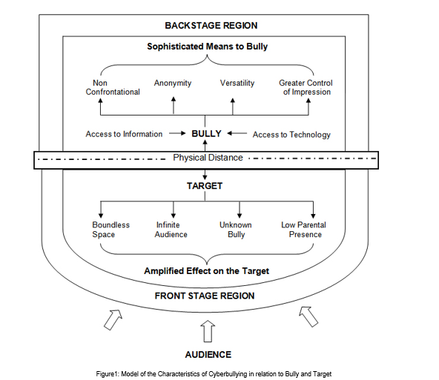

Slide 15



Design and Methodology

Slide 16
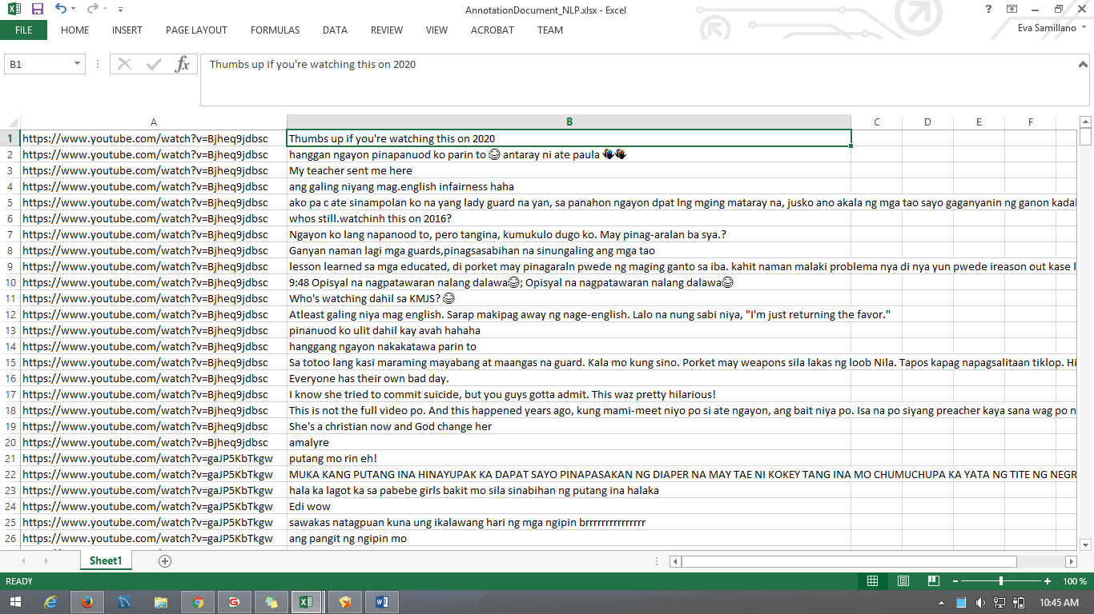
Design and Methodology
Imported Data

Slide 17
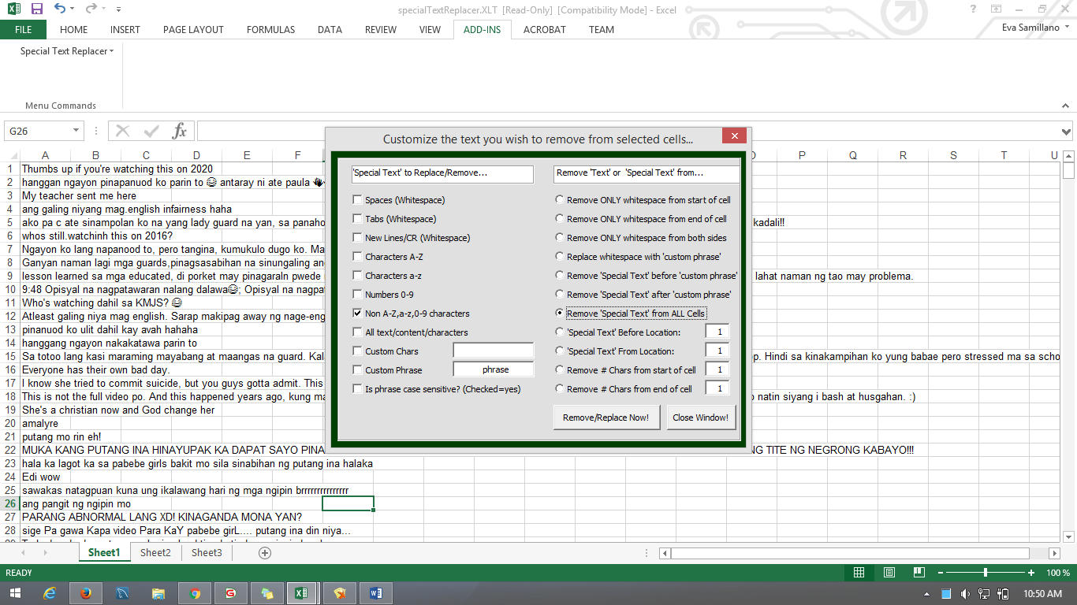
Design and Methodology
Cleaning the data using Excel

Slide 18
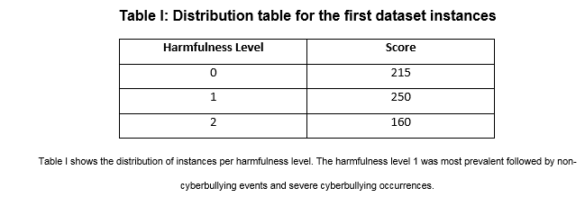
Design and Methodology

Slide 19
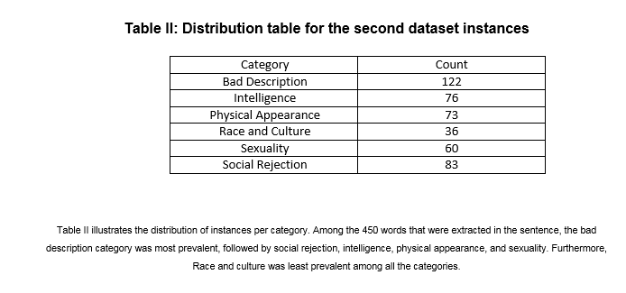
Design and Methodology

Slide 20
Design and Methodology
Sexuality – instances that contains both vulgar and filthy words.
Physical Appearance – instances that contains cyberbullying statements with regards to the physical characteristics of a person.
Intelligence – instances that attacks the mental capacity of a person.
Race and Culture – instances that contains both racial and cultural discrimination.

Slide 21
Design and Methodology
Social Rejection – instances that contains cyberbullying statements which isolates an individual from the society or it degrades a person.
Bad Description – instances that contains cyberbullying statements that pertains to the attitudes and behaviour of an individual. However, this categorization can be misused with the Physical Appearance.

Slide 22
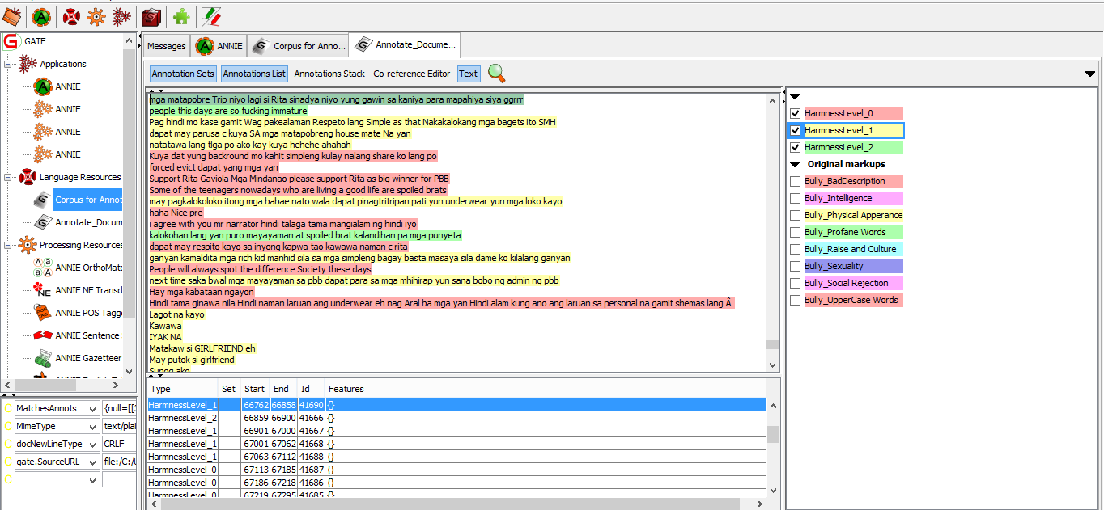
Design and Methodology
Using GATE – Annotating the Harmness of Sentence

Slide 23
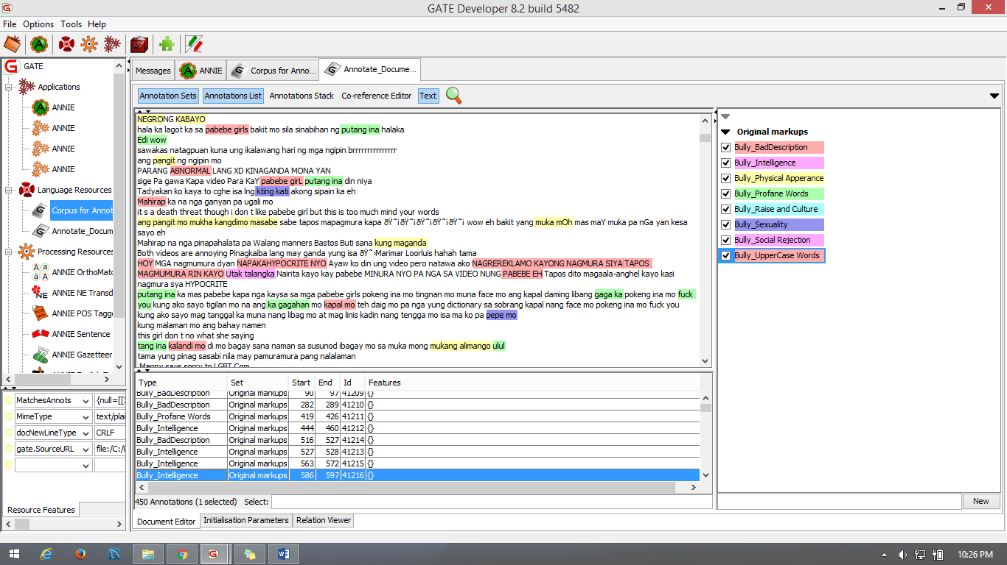
Design and Methodology
Using GATE - Annotating Bully Category

Slide 24
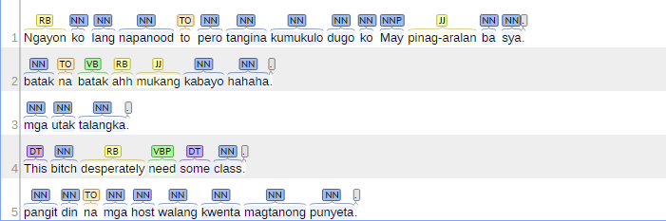
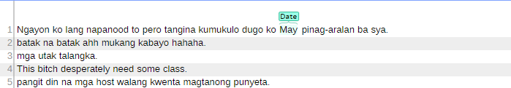
Design and Methodology
Part of Speech
Name Entity Recognition

Slide 25
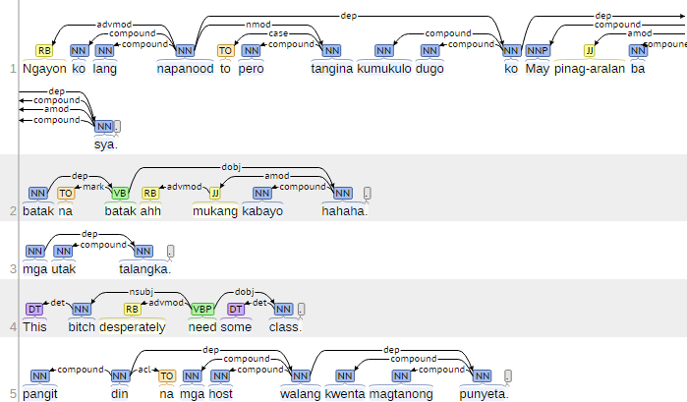
Design and Methodology
Basic Dependency

Slide 26
Result and Discussion
Out of 625 statements that were extracted from the social media sites, the harmfulness level 1 was most prevalent with a frequency of 33%. It was followed by non-cyberbullying events, with a frequency of 41%. The occurrences of severe cyberbullying events was least prevalent among the three classification, it has a frequency of 26%.

Slide 27
Result and Discussion
At the second level of annotation, the bad description was the most prevalent with a frequency of 27%, it was followed by Social Rejection (18%), Intelligence (16%), Sexuality (13%), Physical Appearance (10%) and the category Race and Culture was the least prevalent among the six categories, it has a frequency of 8%.

Slide 28
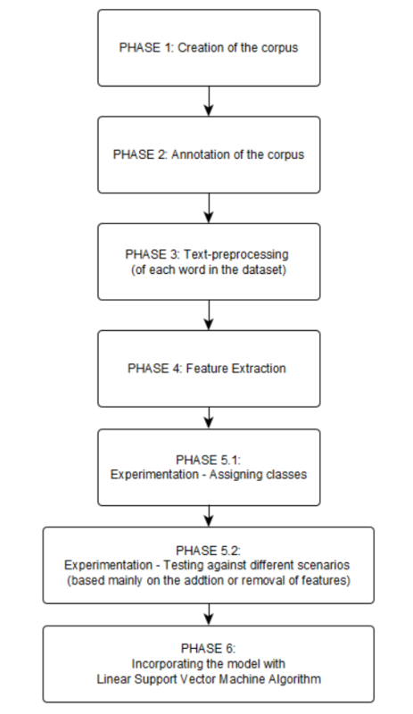
Project Diagram

